Slide 1
Evaluation of performance of eGPU using Stereo Vision algorithm
Shriraam Mohan | Student, MS, ICT Innovation | AES group, TU-Berlin

Slide 2
Contents
Problem Statement.
Contribution.
Brief on stereo vision.
Assumptions.
Algorithm.
EGPU.
Implementation.
Programming.
Current results.
Conclusion.

Slide 3

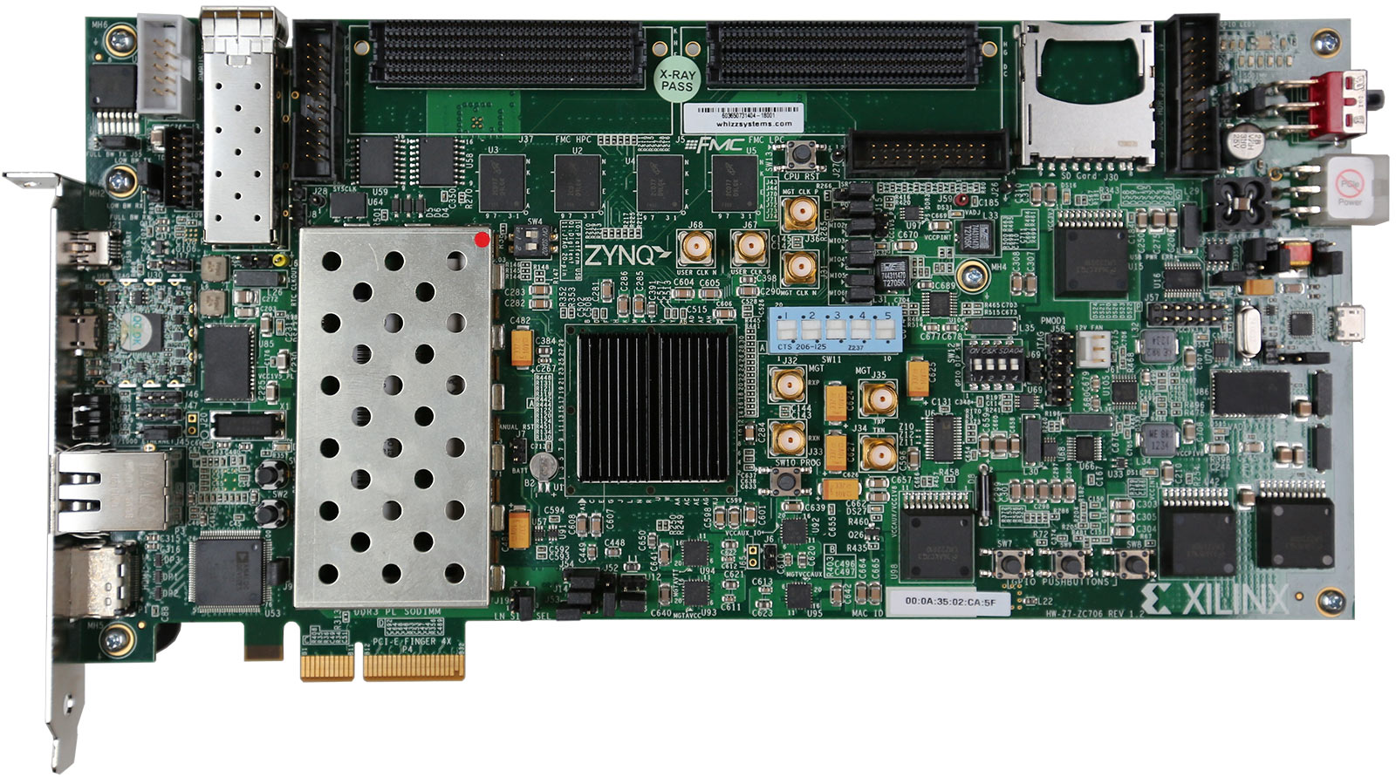
Problem Statement
Think Silicon Ltd. has come up with new series of eGPU called nema.
Performance of the GPU needs to be compared with existing hardware for a real world application.

Slide 4
Contribution
The run time of a stereo vision algorithm and the percentage of bad pixels it produces is compared with implemetation in Zync 7000 processor and Intel core i3 processor.
Optimisation of algorithm implementation for eGPU and comparison architecture.
Any bottleneck in performance detected due to architecture of the eGPU is reported.

Slide 5
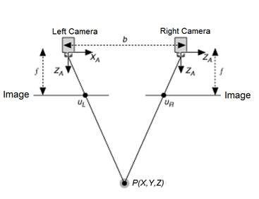
Stereo vision
Stereo vision involves extraction of depth information from multiple camera images of the same scene.
(image source: www.ni.com)

Slide 6
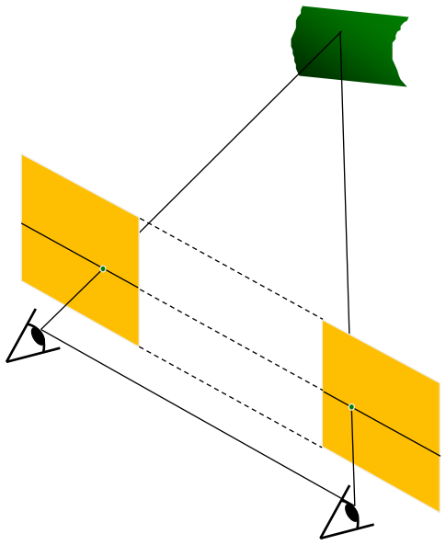
Assumptions
Cameras are synchronous (images are taken by the camera at same instant)
Image planes of cameras are parallel to each other and to the baseline
Camera centers are at same height
Focal lengths are the same
(source: Epipolar Geometry and Stereo Vision - University of Illinois - Derek Hoiem)

Slide 7
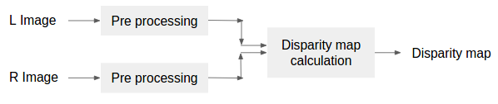
Algorithm

Slide 8

Pre-processing
Morphological opening by 3x3 square structure
Census transform with 11 x 11 window size

Slide 9
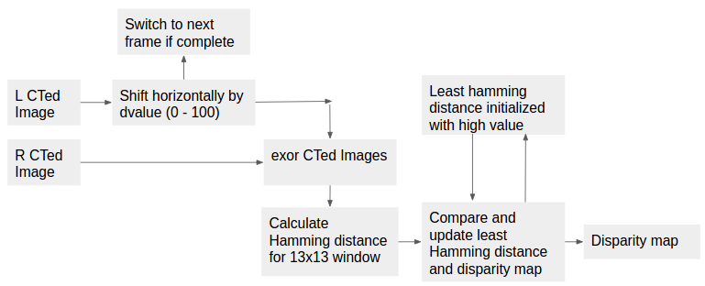
Disparity map calculation (SHD) – most optimised

